Slide 1
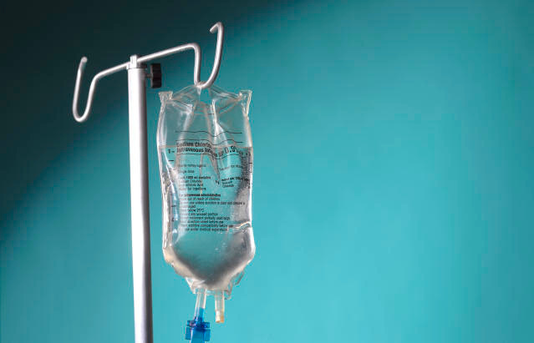

IV BAG MONITORING MONITORING AND
ALERT SYSTEM
SANDHYA S - 210701226
SHANDHIYA N S - 210701240

Slide 2

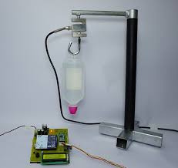

Agenda
Introduction
Purpose
Components involved
Circuit diagram
Results
Conclusion and Future Enhancement

Slide 3

Introduction
Introducing the Smart IV Bag Monitoring and Alert System, an innovative technology designed to enhance patient safety and streamline healthcare operations. This system integrates advanced sensors and wireless communication technologies to continuously monitor the status of IV bags in real-time. It provides instant alerts to healthcare professionals about critical changes, such as fluid levels, flow rates, and potential blockages, ensuring timely interventions..
This IoT Intravenous Fluid Monitoring uses a weight sensor to detect as the fluid level in the IV Infusion bottle goes down and transmits the data over IoT.
Once the system detects that the bottle has gone empty, it sends an alert over IoT

Slide 4
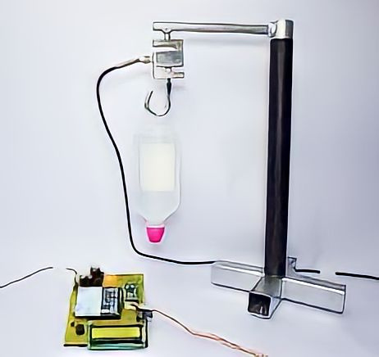
Purpose
Precise monitoring of flow rates and fluid levels ensures that patients receive the correct amount of medication or fluids at the prescribed rate.
By minimizing the reliance on manual processes, the system reduces the potential for human error in IV monitoring, contributing to more reliable and consistent patient care
By providing continuous, real-time monitoring of IV bag status, the system aims to reduce the risk of complications such as air embolisms, infections, and incorrect fluid dosages.
Instant alerts for any anomalies ensure that healthcare providers can respond promptly to prevent adverse events.

Slide 5
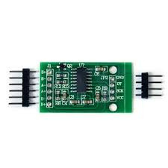
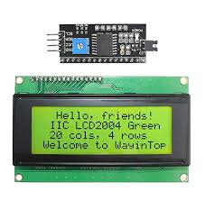


Hardwares Involved
HX711 module
LCD Display with I2C
Load Sensor

Slide 6
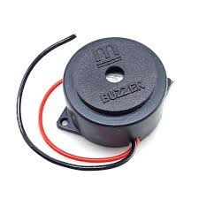
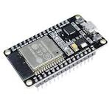
Hardwares Involved
Buzzer
ESP32

Slide 7


Softwares Involved
Blynk
Arduino IDE

Slide 8
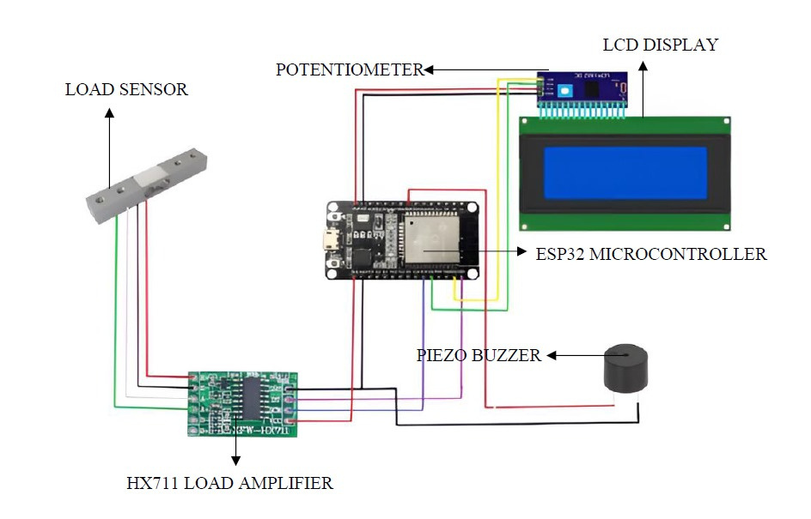
Circuit Diagram

Slide 9
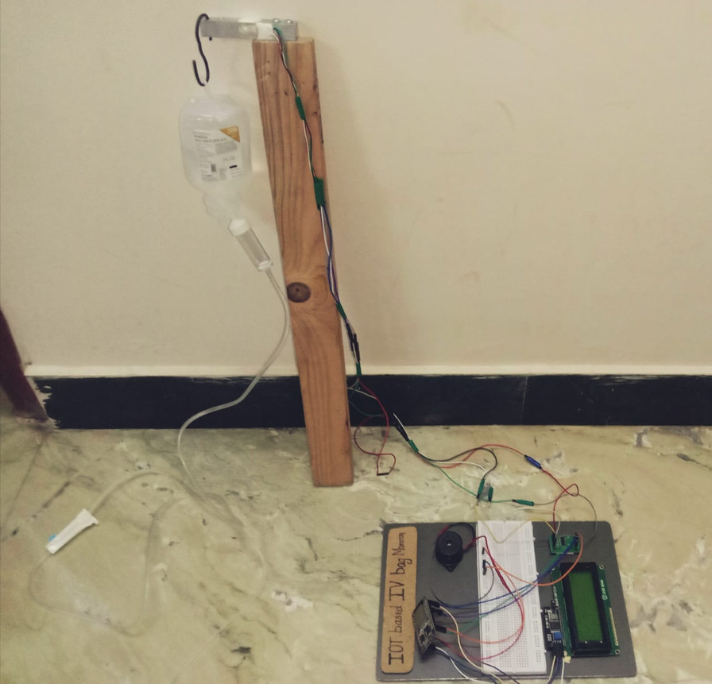
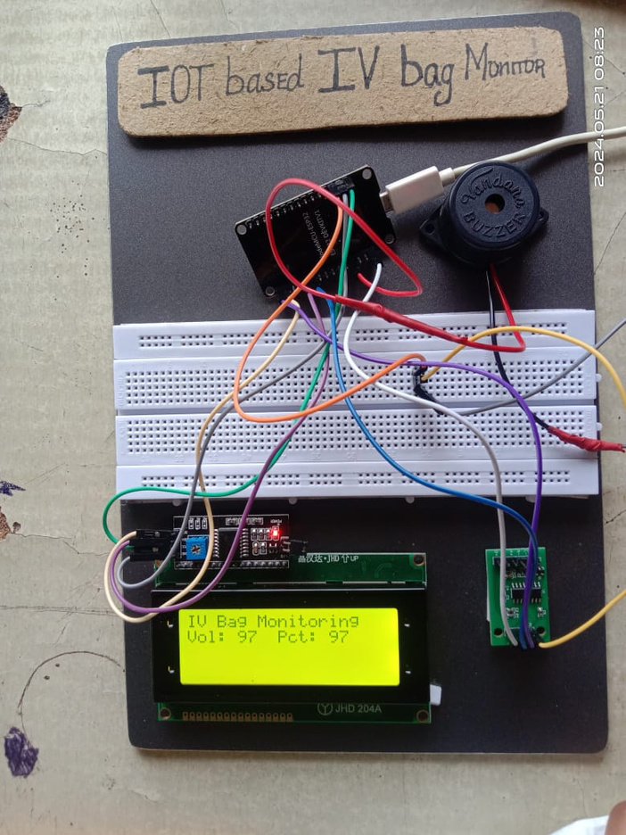
OUTPUT

Slide 10
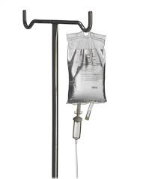
Conclusion and future enhnacement
These systems can help healthcare professionals to accurately monitor the delivery medications and fluids, detect any deviations from prescribed dosages or flow rates .
They can help reduce the risk of medication errors, improve patient outcomes, and reduce healthcare costs.
By providing real-time monitoring of intravenous therapy, healthcare providers can quickly identify and respond to issues, such as changes in fluid levels, that could negatively impact patient care.
Remote monitoring capabilities could allow healthcare professionals to monitor patients receiving IV therapy outside of the hospital or clinic setting,
AI and machine learning could be used to analyze data from IV bag monitoring systems to predict potential complications, such as blockages or air bubbles, and provide alerts to healthcare professionals.

Slide 11
Thank
You

